Slide 1

Database Theory and Applications for Biomedical Research and Practice BMIN 502 / EPID 635 Week 11: Introduction to graph database
John H. Holmes, PhD

Slide 2
Agenda
Introduction to graph models
Modeling a toy problem as a graph
Modeling ABIC as a graph
Graph databases
Graph modelsGraph query languages
Introduction to neo4j

Slide 3
Two types of graph models
Resource Description Framework (RDF)
Generic “metadata model” originating in the semantic web
Uses a triple construct (subject-predicate-object): “The patient takes Tylenol”
Strongly indexed
Nodes and edges have no internal structure
Labeled Property Graph
Used in Neo4j
Index-free
Nodes and edges have internal structure

Slide 4
The Labeled Property Graph Model
A graphical representation of concepts and the relationships between them, with the properties associated with each
:HAS_NURSE
start_date: 2017/4/12
employee_ID: 30954
City
Employee
:LOCATED_IN
name: John Smith
dob: 1967/12/19
mrn: 12345678
Hospital
:has

Slide 5
Thus…
Nodes
Equivalent to entities
Contain properties
Attribute-value pairs
Labels indicate identity
Relationships
Express the semantics between nodes
Always connected between two nodes, never broken or “orphaned”
Directional
Properties
Indicate possession, quantitative measures, strength, state, etc.

Slide 6
Compare RDF and LPG models
Resource Description Framework
Labeled Property Graph
Not possible to uniquely identify instances of a relationship
Impossible to have connections of the same type between the same pair of nodes, because that would duplicate the triple
You can’t provide attributes for relationships
You can uniquely identify all instances of a relationship
Can lead to huge graphs!
Relationships can and do have attributes
Much more versatility in querying

Slide 7
An RDF graph
Note how every concept is ultimately atomicized!
(E.g., values of attributes are represented as nodes.)

Slide 8
An LPG graph
Note how every concept represented in nodes with an internal structure.

Slide 9
How to create a graph model: Step 1: Identify the domain
This will be the tableau of the graph, characterized as nodes (“nouns”) and relationships (“verbs”)
Example: John, Mary, Bill, and Ellen are patients at UPHS practices. John and Mary go to 3701 Market Internal Medicine, Ellen goes to 8th and Spruce, and Bill goes to Family Medicine at 39th and Chestnut.

Slide 10
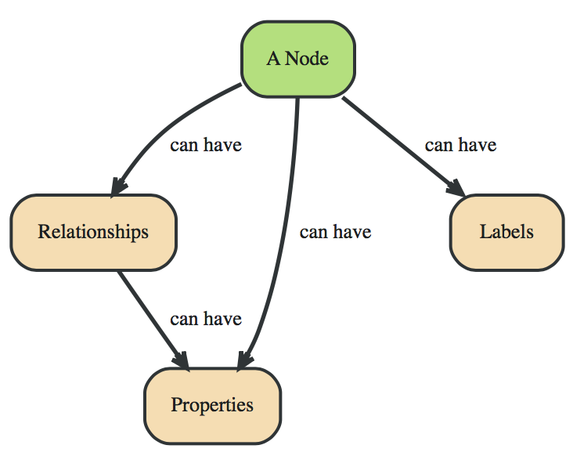
How to create a graph model: Step 2: Identify the nodes

Slide 11
How to create a graph model: Step 2: Identify the nodes
John, Mary, Bill, and Ellen are patients at UPHS practices. John and Mary go to 3701 Market Internal Medicine, Ellen goes to 8th and Spruce, and Bill goes to Family Medicine at 39th and Chestnut.

Slide 12
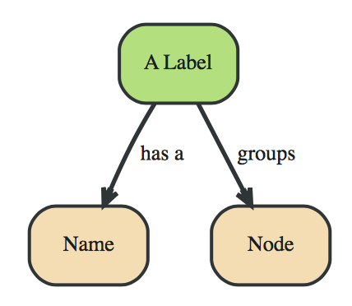
How to create a graph model: Step 3: Specify the node labels
Labels define sets
Equivalent to the name of an entity, which is an abstraction (“a patient”, not “the patient”)
Important to the functioning of the graph database

Slide 13
How to create a graph model: Step 3: Specify the node labels
John, Mary, Bill, and Ellen are patients at UPHS practices. John and Mary go to 3701 Market Internal Medicine, Ellen goes to 8th and Spruce, and Bill goes to Family Medicine at 39th and Chestnut.
John
Mary
Bill
Ellen
Internal medicine
Family practice
:Patient
:Practice
Note the colon!
It denotes a label.

Slide 14
How to create a graph model: Step 4: Apply the labels as roles
John
Mary
Bill
Ellen
:patient
Internal medicine
Family practice
:practice
Colors aren’t absolutely necessary, but they help to indicate
the distinction between labels and roles

Slide 15
How to create a graph model: Step 5: List the relationships
John, Mary, Bill, and Ellen are patients at UPHS practices. John and Mary go to 3701 Market Internal Medicine, Ellen goes to 8th and Spruce, and Bill goes to Family Medicine at 39th and Chestnut.

Slide 16
How to create a graph model: Step 6: Draw the graph and generate the code
We will return to this!

Slide 17
Now, how about ABIC as a graph?
Let’s model it

Slide 18
Graph Databases

Slide 19
What is a graph database? Wikipedia says it well…
Uses graph structures (rather than tables)
Allows semantic queries
Rretrieval of both explicitly and implicitly derived information based on syntactic, semantic and structural information contained in data
The graph explicitly relates data items
Nodes instantiate items
Relationships link data in nodes directly, without need for joins
https://en.wikipedia.org/wiki/Graph_database

Slide 20
Comparison of relational and graph databases
Relational
Graph
Storing and manipulating relationships are difficult
Performance degrades with increasing number and complexity of relationships
Queries get complex real fast, when you rely on a lot of joins
Adding new relationships, tables, and types of data requires schema redesign
Can handle large volumes of heterogeneous data
Graph models are intuitive
Model and data stored as a graph
Data relationships can be queried quickly (real-time)
Can be updated without requiring schema redesign

Slide 21
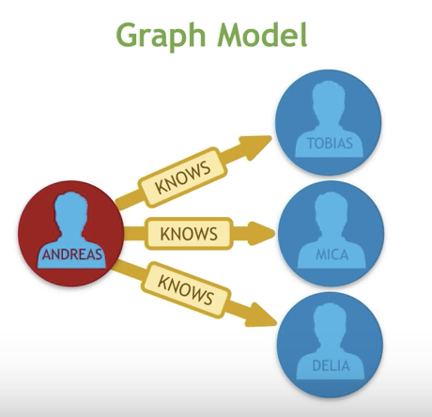
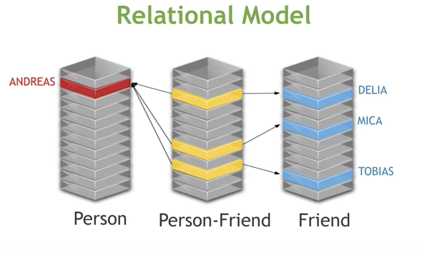
Another view: Look at the relationship flexibility…
And think about the complexity of the joins required for the relational model!

Slide 22
Graph query languages

Slide 23
Query languages in graph databases: SPARQL
SQL-like language for querying RDF graphs
1 2 3 4 5 6 | PREFIX foaf: SELECT ?craft ?homepage { ?craft foaf:name "Apollo 7" . ?craft foaf:homepage ?homepage }

Slide 24
Query languages in graph databases: Gremlin
Graph traversal language for querying in a variety of platforms and within other languages (Python, Java, JavaScript, etc.)
1 2 3 4 5 6 | def gt=graph.traversal(); gt.V() .hasLabel("band") .has("genre",within("indie","HipHop","Techno/EDM")) .outE("performing_at") .inV().path();

Slide 25
Query languages in graph databases: Cypher
Declarative query language for Neo4J
MATCH (n1:Label1)-[rel:TYPE]->(n2:Label2) WHERE rel.property > {value}
RETURN rel.property, type(rel)
1 2 3 4 | MATCH (n:Person)-[:FRIEND]-(f) WITH count(f) as c, n MATCH (n)-[:FRIEND]-()-[:FRIEND]-(fof) RETURN n, c, fof

Slide 26
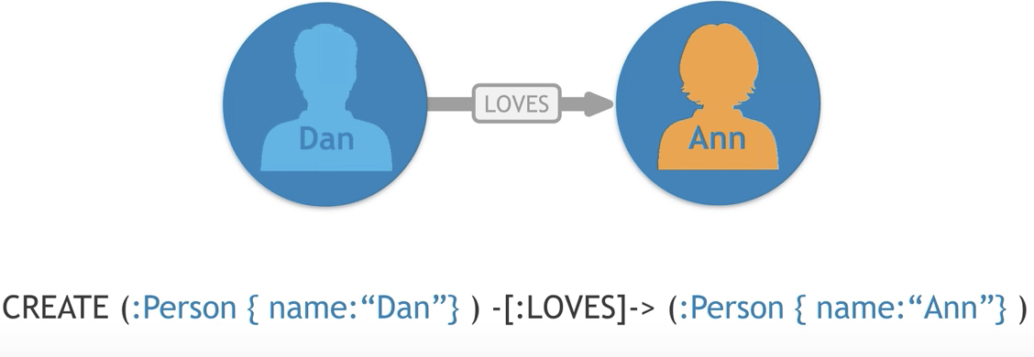
A simple Cypher query https://www.youtube.com/watch?v=83P81ebgCxA
Predicate
Label
Property
Relationship
Label
Property
This query inserts two nodes into the database, each with an
instantiated property (name) and an instantiated relationship (:LOVES)

Slide 27
Running neo4j: A first run
Open the application
Click on New
Click on create New Graph and then Create a Local Graph
Enter a name and password for the database and click on Create
Click Start
Click on the name of the DB in the lower left and click on Open Browser
Click on Write Code button (in center)
Click on Create a graph (Movie Graph)
Let’s walk through the tutorial together

Slide 28
How to create a graph model: Step 6: Draw the graph and generate the code
Start the Arrow Tool: www.apcjones.com/arrows/#
Instantiate your graph from Step 5 using the Arrow Tool
Export the Cypher code and open in the Console
Copy and paste the code into the Browser
Visualize your graph there

